Slide 1
What is a UNICEF UK child friendly city/community?
A place where the local council and their partners have committed to advance children’s rights and have worked with UNICEF UK to put them into practice
And a place that has demonstrated how more children feel safe, heard, cared for and are able to flourish as a result
Notes:
Important to note that recognition as a UNICEF UK Child Friendly City or Community is not an endorsement of the child rights situation across the whole of the city or community. It is a recognition of a city or community’s commitment to using children’s rights as a tool to guide decision-making, evidenced by real impact for local children and young people.
Progress will be assessed through a mixture of self-evaluation (six-monthly reports), an advisory board of local children and young people, as well as an independent panel of experts on human rights, child wellbeing and public services
There will always be more work to do to in every city or community before children’s rights are fully respected

Slide 2
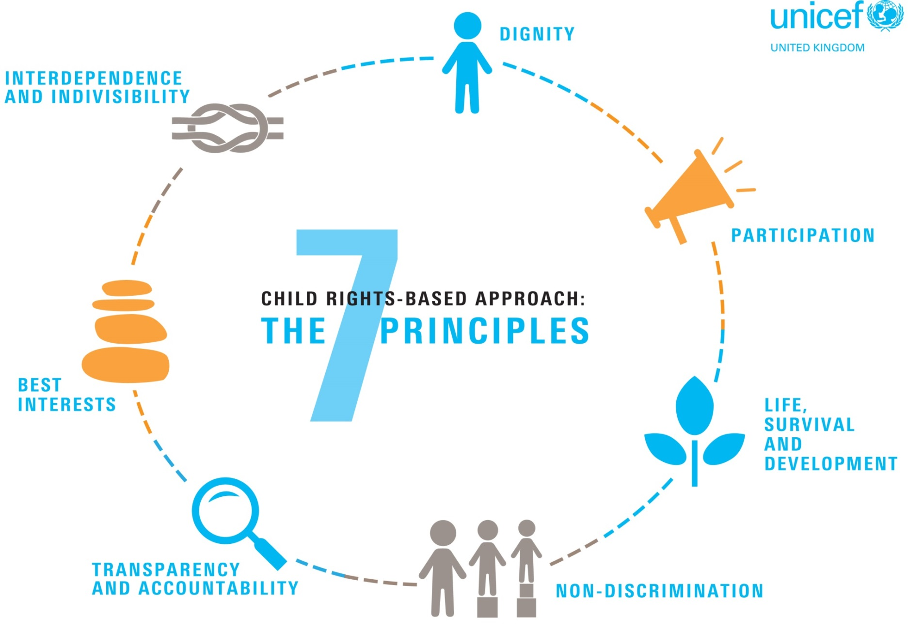
Notes:
A child rights-based approach is made up of seven principles based on the UN Convention on the Rights of the Child and general human rights principles
In the early stages of the programme, elected members, council staff, commissioned services and local partners receive expert UNICEF UK training on what a child rights-based approach is and how they can apply it to their work
They can then go on to use this practical tool whenever they make decisions that directly or indirectly impact children

Slide 3
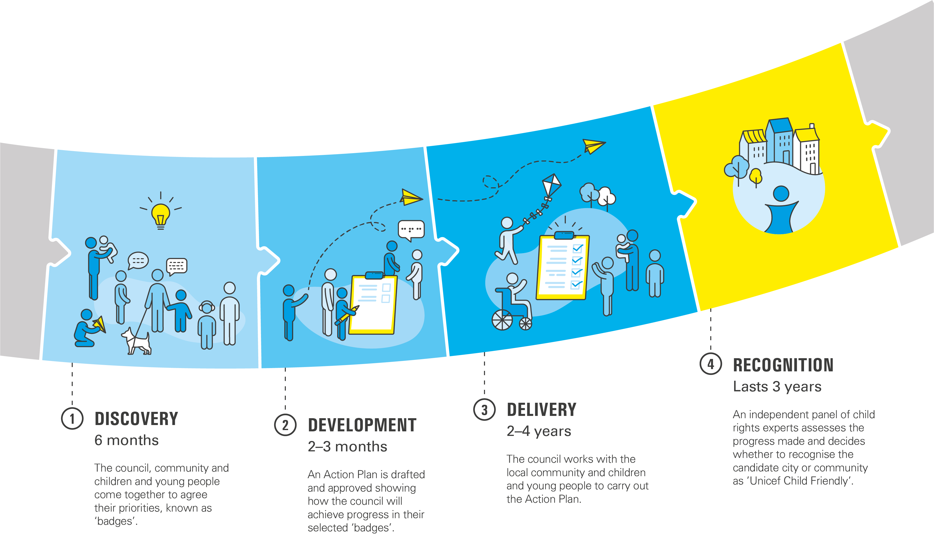
Notes:
There are four stages to the CFC journey and UNICEF UK provides expert training, capacity-building, technical assistance, mentoring and communications support at every stage

Slide 4
CFC Strategy 2018

Slide 5
DELIVERY – 2-4 YEARS
Family
Health
Education
Measurable progress in all six badges
Culture
Leadership
Communication

Slide 6
RECOGNITION – LASTS FOR 3 YEARS
Measurable progress in all six badges
UNICEF Child Friendly City or Community – Recognition can continue to be renewed for three-year periods if there is sufficient evidence of sustained progress
Submit evidence backed up by testimony from children and young people
Commit to self-regulate and alert Unicef UK of any significant changes
Submit Three-Year Plan and evidence sustained progress for renewed recognition

Slide 7
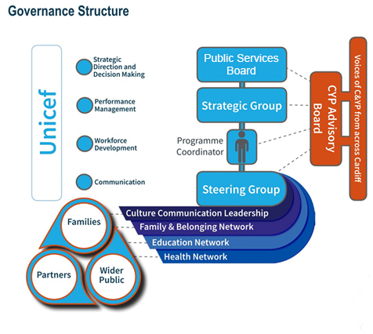
Road To Recognition
Strategic Group
Reps across badge structure
Health, Education, Children’s Service, Communities
To meet December, March & June
Operational Group
Reps across badge structure
Health, Education, Children’s Service, Communities
To meet monthly Oct - July
Performance & Evidence
To measure performance over time
Provide a suite of evidence as required by Unicef assessment

